Slide 1
Sentiment Analysis on Donald Trump
WQD180102 Ng Wei Xin
WQD180104 Tan Bng Shien

Slide 2

Milestone 1: Data Scrapping

Slide 3
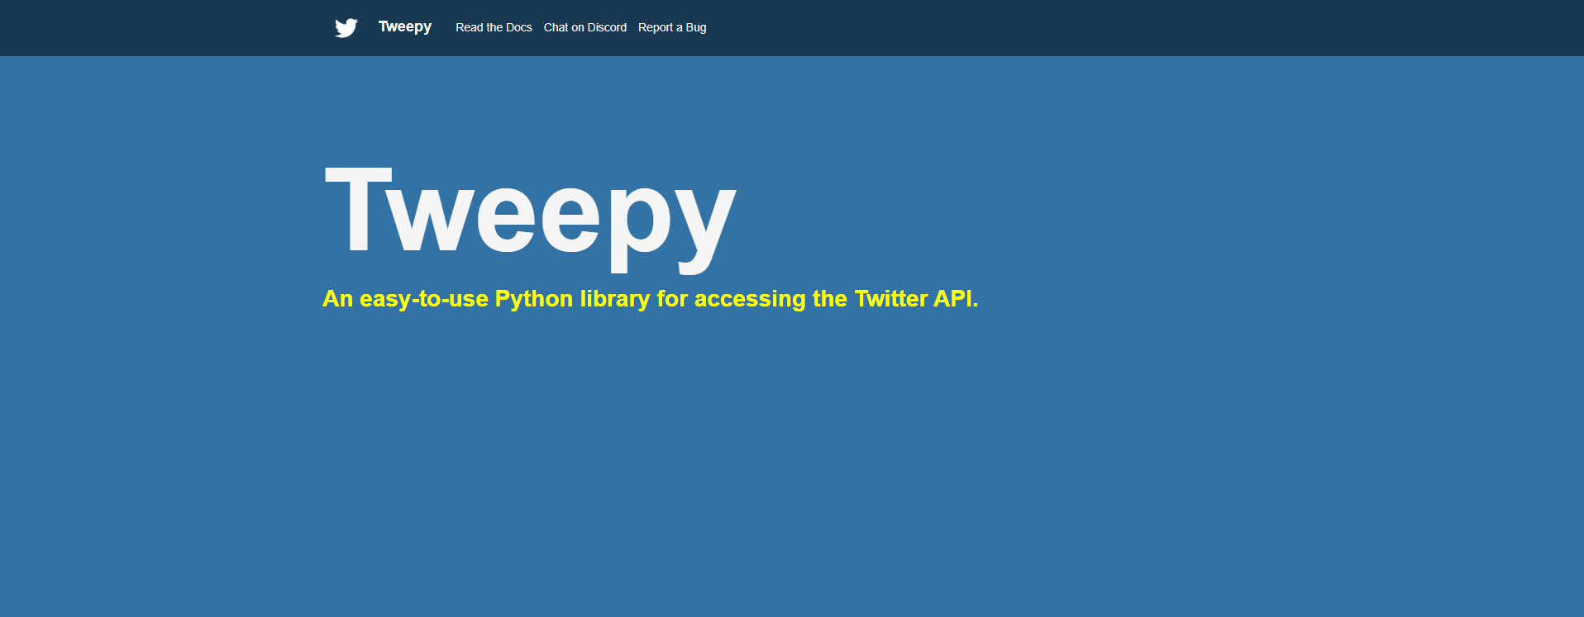
Milestone 1: Data Scrapping

Slide 4
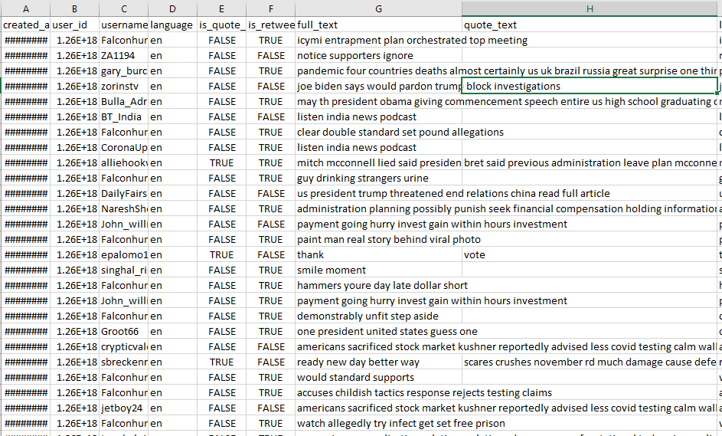

Slide 5
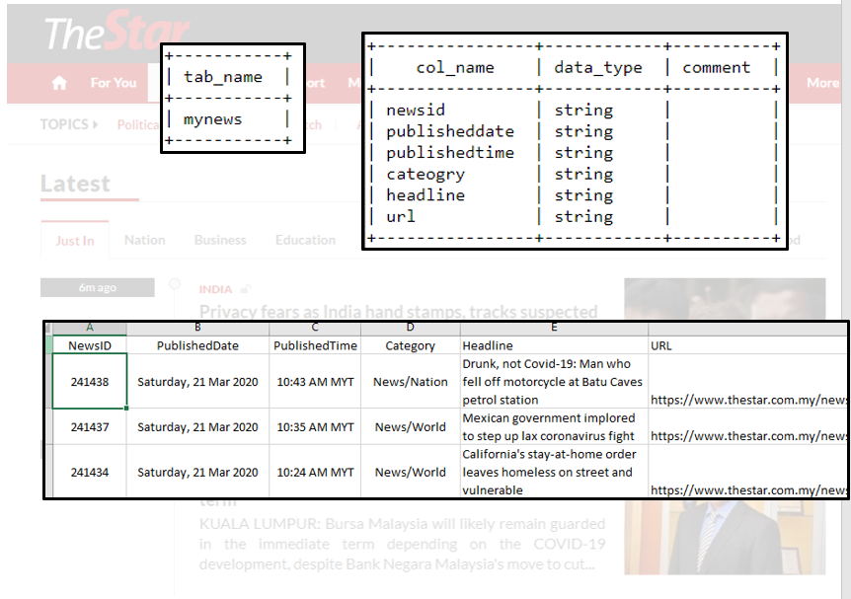
Milestone 2: Data Warehouse

Slide 6
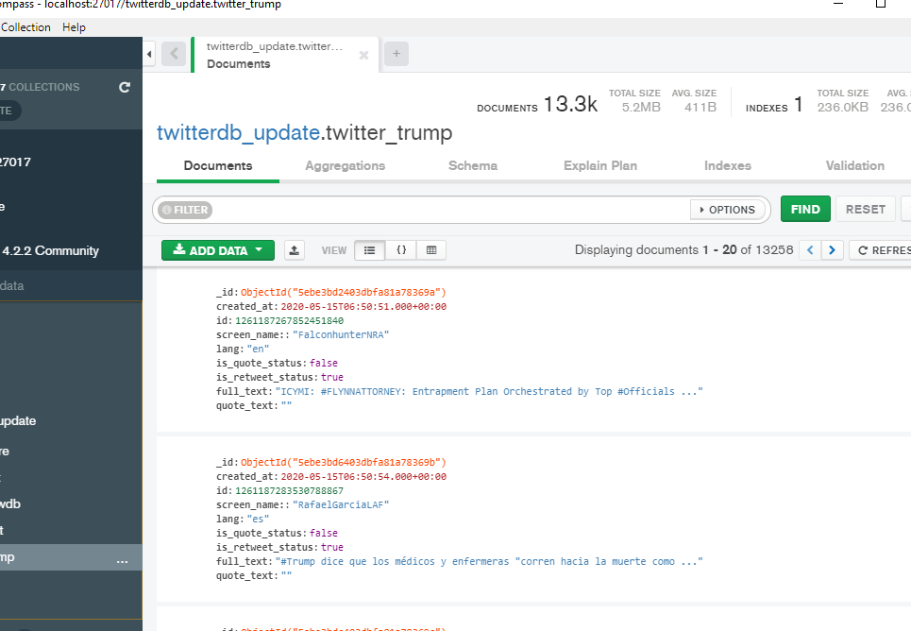
Milestone 2: Data Warehouse

Slide 7
Milestone 3: Data Preprocessing
Missing values
Duplicated values
Data Types
Text-Preprocessing

Slide 8
Milestone 3: Data Preprocessing
Text-Preprocessing
Filter language
Normalization
Remove emoji
Remove Punctuations
Removing Hashtags and Mentions
Removing stopwords
NLTK (Tokenization, Lemmatization, Stemming)

Slide 9
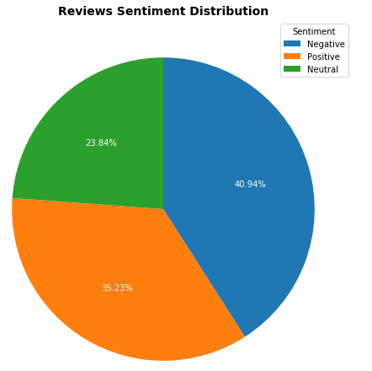
Milestone 4: Data Interpretation

Slide 10
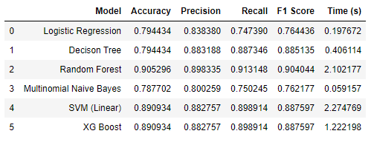
Milestone 4: Data Intepretation

Slide 11
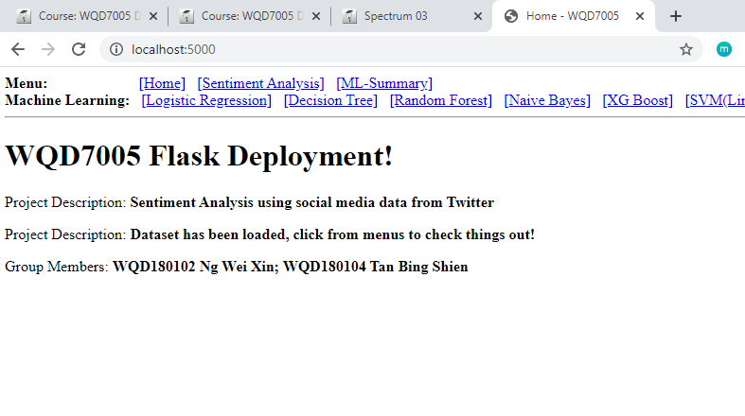
Milestone 5: Deployment

Slide 12
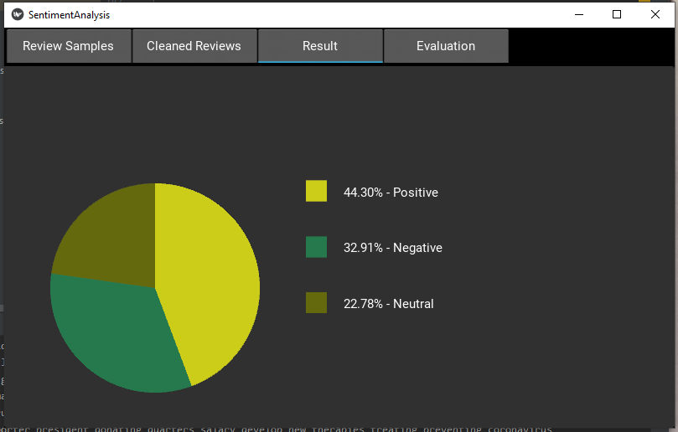
Milestone 5: Deployment

